Slide 1
MGT388 Finance for Engineers
Lecture 6:
CVP Analysis and Budgeting

Slide 2
Lecture Outline
Understand CVP Analysis
Prepare a Break-even chart and calculate the Break-even point for some activity
Understand the main uses, advantages and limitations of CVP Analysis
Appreciate the purposes, merits and limitations of Budgeting

Slide 3
CVP Analysis
Profit = Revenues - Total Costs
Revenues = Total Costs + Profit
Revenues = Fixed Costs + Variable Costs + Profit
(Units sold × Price) = Fixed Cost + (Units sold × Unit Variable Cost) + Profit
The CVP Model:
( Q × P ) = F + ( Q × V ) + N
Q = units sold
V = unit variable cost
F = total fixed cost
P = unit selling price
N = operating profit
P – V = Unit contribution margin
P – V
= Contribution margin ratio
P

Slide 4
CVP Analysis
( Q × P ) = F + ( Q × V ) + N
( Q × P ) - ( Q × V ) = F + N
Q × ( P - V ) = F + N
P – V = Unit contribution margin
If profit is zero (N = 0):

Slide 5
Example 1: Saman Household Furnishings, Inc.
 | Annual | Per unit
Sales (3,000 units x $75) | $ 225,000 | $75
Variable cost (3,000 units x $35) | $ 105,000 | $35
Fixed cost | $ 60,000
 | $ 165,000
Profit | $ 60,000
Planned Sales | 3,000 units
5

Slide 6
CVP Analysis for Breakeven Planning Methods for determining BEP and target operating profit
I. The Equation Method:
$75 × Q = $60,000 + ($35 × Q)
Selling price per unit
Total fixed cost
Variable cost per unit
($75 x Q) - ($35 x Q) = $60,000
($75 - $35) x Q = $60,000
Q = $60,000 ÷ $40 Q = 1,500 units per year
6

Slide 7
CVP Analysis for Breakeven Planning Methods for determining BEP and target operating profit
II. Contribution Margin Method
Q =
F
P - V
$60,000
$75 - $35
Q =
Q = 1,500 units per year
F
(P - V) ÷ P
$60,000
($75 - $35) ÷ $75
P × Q =
P × Q =
P × Q = $112,500 per year
7

Slide 8
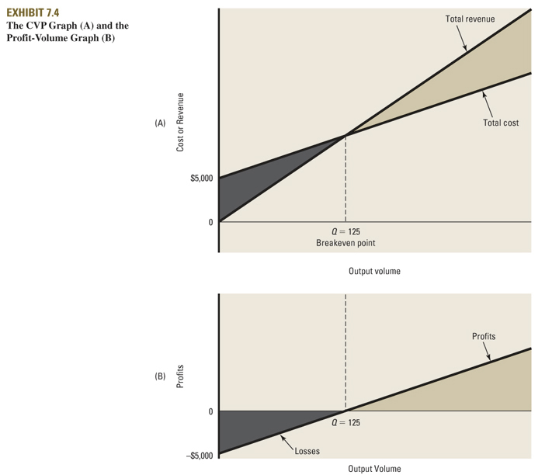
Profit
$112,500
Loss
$60,000
Fixed cost
Q=1,500
Breakeven point
Q=1,500
- $60,000
8
Blocher et al., 2005

Slide 9
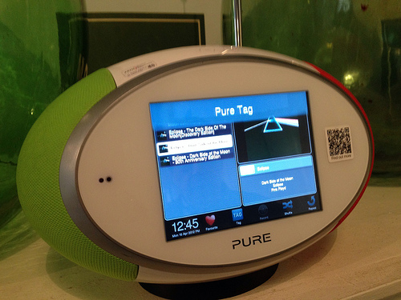
Example 2: digital radios
Using the formula, the number of units that need to be produced and sold to break-even can be calculated.
Example
A company manufactures and sells digital radios. The selling price is £75, the variable costs (per unit) are £45 and fixed costs are £60,000.
Calculate the break-even point.

Slide 10
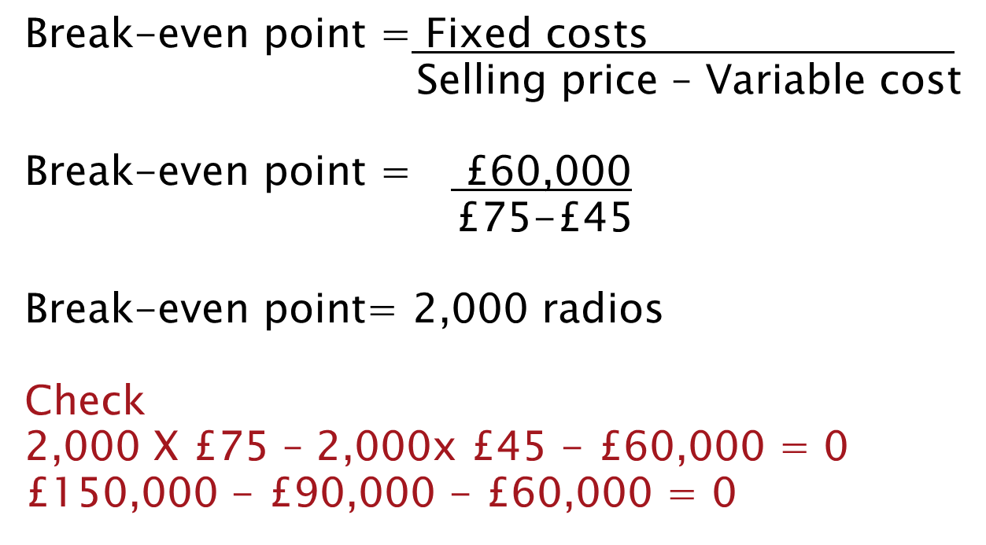
Example 2: BEP

Slide 11
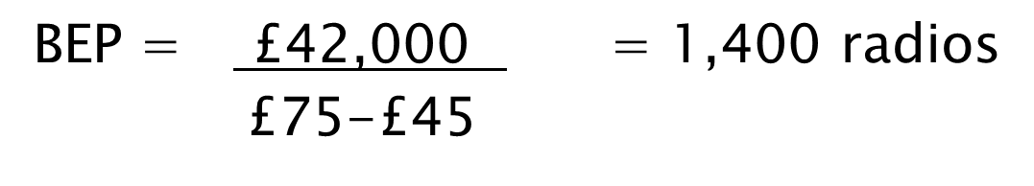
Example 2: BEP
Calculate the BEP for digital radios, if fixed costs could be reduced to £42,000. Sales price £75 and variable cost £45.

Slide 12
Example 2: target profit
Where a business wishes to make a certain level of profit, break-even formula should be used, and target profit added to the fixed costs figure.
Example. For the company making digital radios calculate the number of units that must be produced if a profit of £48,000 is required.
Sales price £75, Variable costs £45, Fixed costs £60,000.

Slide 13
Example 2: target profit
Units to achieve target profit:
Fixed costs + Target profit
Sales price – Variable cost
£60,000 + £48,000 = £108,000 = 3,600 £75-£45 £30
Check
3,600 X £75 -3,600 X £45 -£60,000 = £48,000
£270,000 – £162,000 - £60,000 = £48,000

Slide 14
Example 2: margin of safety
The margin of safety is the excess of planned or actual sales above break-even point.
This can be expressed as a percentage of sales estimate.

Slide 15
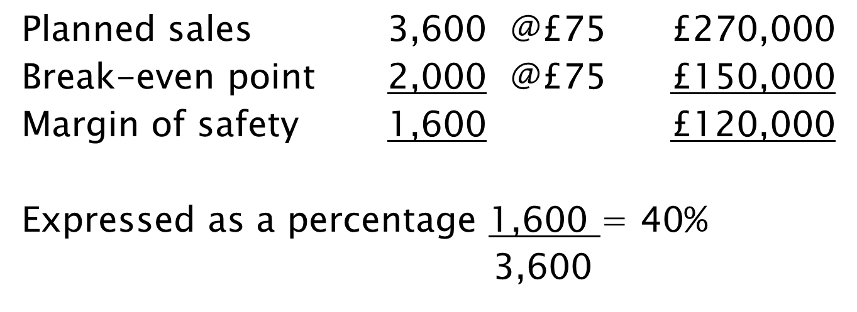
Example 2: margin of safety

Slide 16
Example 2: trade-offs between fixed and variable costs
The management are considering buying a new piece of machinery, which will reduce variable costs but cause fixed costs to increase by £18,000.
To maintain the current profit of £48,000, what will variable costs have to go down to?
Fixed costs were £60,000, variable costs £45 and sales price £75, sales quantity 3,600 radios.

Slide 17
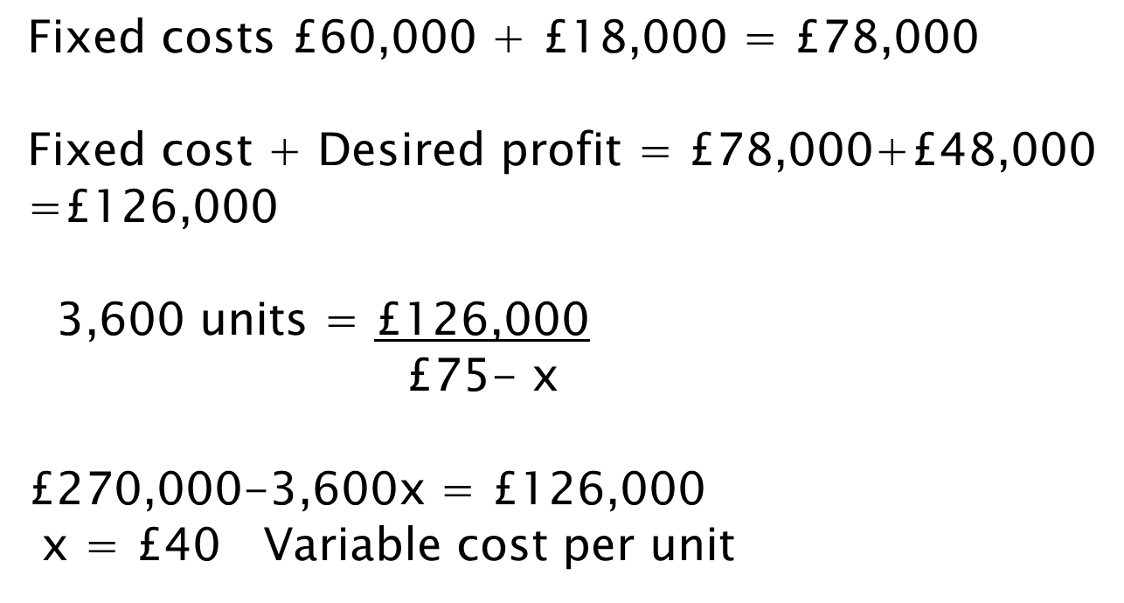
Example 2: trade-offs between fixed and variable costs

Slide 18
Some uses of CVP Analysis
1) Initial Price Setting
When starting a business: high level of fixed costs.
A new business may not be able to achieve a high sales volume, so they set price high or just at level to cover re-occurring fixed costs.
2) Business plan
To know the expected sales targets and margin of safety is an indication of business risk.
3) Marketing
A business can add the cost of marketing to fixed costs, to see the extra sales quantity they need to achieve to be profitable. To offer a discount, a business can look at extra quantity to maintain profits.

Slide 19
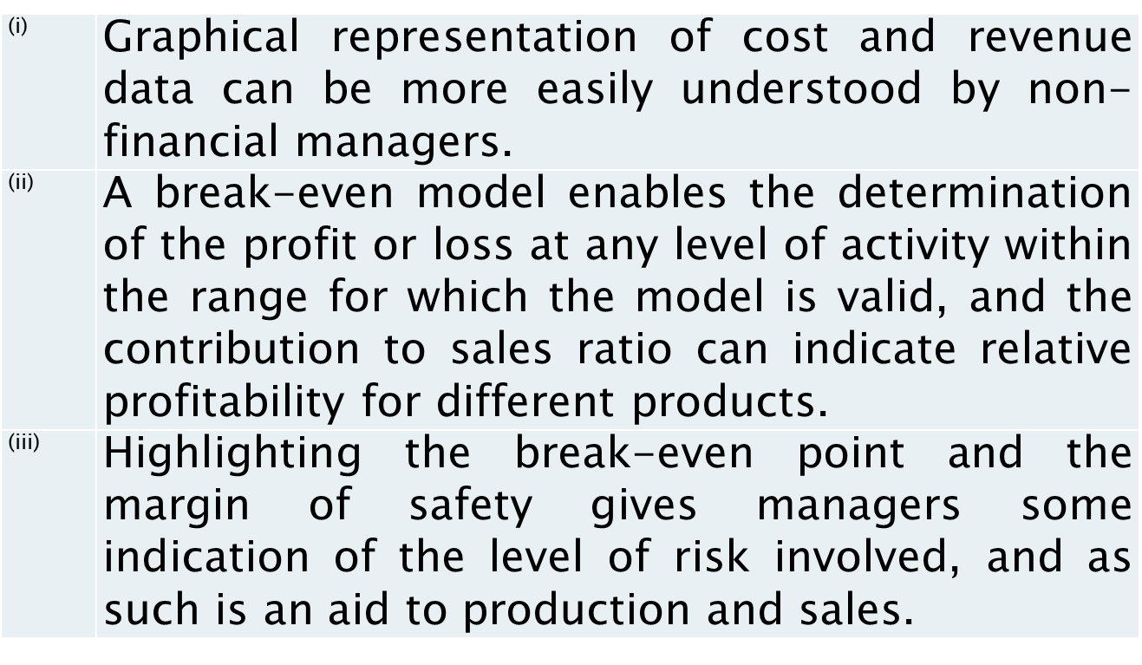
Some advantages of
CVP Analysis

Slide 20
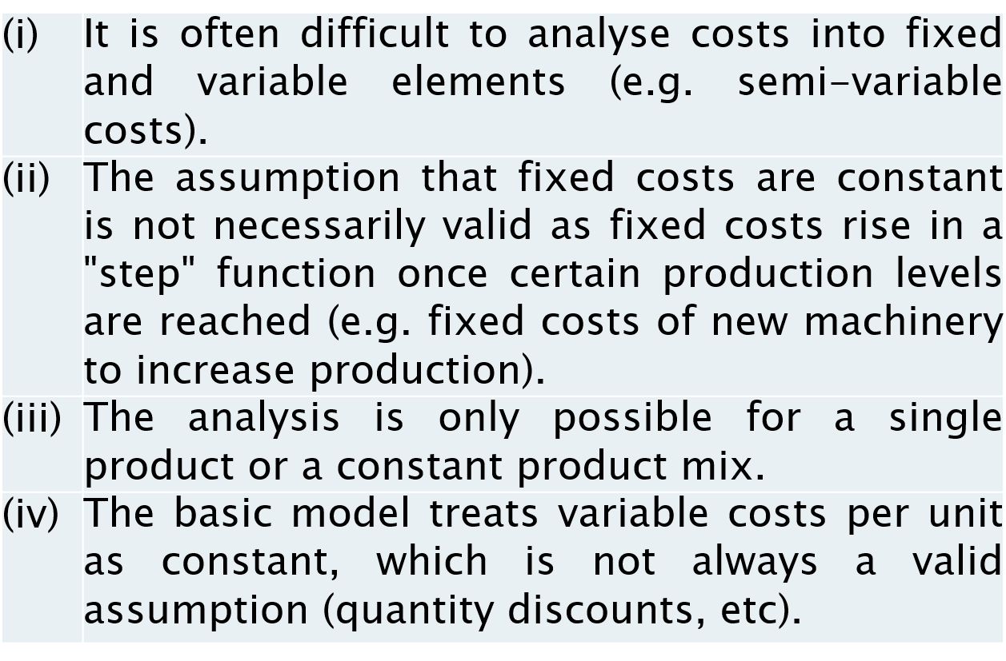
Some limitations of
CVP Analysis

Slide 21
Introduction to Budgets预算
A budget is a plan, usually expressed in financial terms
it is similar to a forecast, but conveys intent (objectives)
resource allocation
it should be related to strategic plan, formulating long term (3-5 years) and overall strategies, goals, performance indicators and targets
Functional budgets细分的: Budgets set for each function of the business (e.g. sales, production)
为业务的每个职能（例如销售、生产）设置的预算
Master budge总的: The single, overall budget, which brings together and summarises the other (subsidiary) budgets
单一的总体预算，汇集并汇总其他（附属）预算

Slide 22
Budgets: period and responsibility
What is the normal budget period?
Commonly the accounting year, subdivided into quarters or months (except for capital expenditure)
通常为会计年度，细分为季度或月份（资本支出除外）
Who is responsible for preparing the budget?
Functional or Departmental managers 职能或部门经理
Budget committee often set up to co-ordinate activities
经常设立预算委员会来协调活动
Who is the Budget Holder?
Someone to whom a budget has been assigned and is held, responsible for achieving the budget, and will receive periodic budget reports (e.g. director of production, marketing manager,…).
已分配预算并持有预算的人，负责实现预算，并将收到定期预算报告（例如生产总监、营销经理,...）。

Slide 23
Budgeting
The actual process of preparation is called budgeting.
(1) Preparing Budget (Budget Setting)
and
(2) Subsequently Comparing Actual Results to Budget (Budgetary Control or Accounting for Control) so that action may be taken to control the organisation’s resources and processes (Management by Exception)

Slide 24
Master Budget
Forecasts of:
cash received and cash payable
revenues and expenses
state of financial health
Found in:
cash flow forecast (cash budget)
budgeted profit & loss account (budgeted ‘income statement’)
budgeted balance sheet 预算资产负债表
Master budgets cannot be drawn up until the sub-budgets for revenues (e.g. sales income) and for expenses (e.g. stock, labour, overheads) are drawn up.
在编制收入（如销售收入）和费用（如库存、人工、间接费用）的次级预算之前，不能制定总预算。

Slide 25
Operating budget and financial budget

Slide 26
Organisational framework
Organisational culture and management style
will determine how budgets are established and used
top up
authoritarian negotiated? participative
down bottom
Responsibility accounting principle
budget preparation & structure reflect organisation structure and scope of managerial authority
budget ‘centres’ hold managers to account for costs, revenues, profits, or returns on investment that reflect their responsibilities over resources, sales, or business units
Notes:
Budget centres
Cost Centre, common in functional structures
control thro’ variance & measures of economy
Profit Centre, suitable for product managers
control thro’ sales volumes & prices & measures of efficiency
Investment Centre, suitable for divisional structures
control through return on assets

Slide 27
Budgeting approaches
Rolling budgets - Continuous review and budgeting, so we always have a full year budget. As each month elapses结束 another month is added to the end of the budget.
Advantages: Reduce uncertainty; more realistic
Disadvantages: Costly
Incremental budgeting 增量预算 – uses the previous budget as a base.
Advantages: Easier and less expensive
Disadvantages: Project the past into the future, possible gaps with strategic planning and/or inefficiencies
Zero-based budgeting - Non incremental and starts from scratch. 非增量，从头开始 Activities may be ranked in order of importance.
Advantages: Identify inefficient or obsolete 过时 operations
Disadvantages: Time consuming 耗时; ranking may be difficult.
27v

Slide 28
Flexible budgets
A flexible budget is a budget that adjusts to take into account (potential) changes in the volume of activity. 弹性预算是一种根据活动量的（潜在）变化进行调整的预算。
Flexible budgets are important:
At the planning stage – shows results at a variety of sales volumes (what-if analysis)
Retrospectively 回顾 – At month end (or control period), flexible budgets can be used to compare actual results achieved with what results should have been under the desired circumstances

Slide 29
Standard costing
Standard costing: is the practice of estimating standard unit cost under efficient operations.
标准成本核算：是在高效运营下估算标准单位成本的做法。
Therefore,
Standard cost is a pre-determined cost and can be set for material costs, labour costs, machine hours costs and overheads. 标准成本是预先确定的成本，可以针对材料成本、人工成本、机器工时成本和管理费用进行设置。
Standard costs can be used to prepare material usage, machine utilisation and wages budgets. 标准成本可用于准备材料使用、机器利用率和工资预算。
Stock can be valued at standard cost. 库存可以按标准成本进行估价。

Slide 30
Standard costing
Advantages
Relatively simple record keeping
Used for cost control in variance analysis
Management by exception
Disadvantages
May be difficult to set standard costs for materials – fluctuating prices
Labour efficiency standards may be difficult to set and agree
Standards are usually revised annually. If standards are revised too frequently, they lose their value as standards

Slide 31
Purposes of budgeting
to plan the allocation of resources
to meet strategic objectives
to co-ordinate and communicate
to integrate activities and provide direction
to motivate
to achieve targets
to control the activities of an organisation (Accounting for control)
by analysing variations in performance from that planned
to assess managerial performance
or unit or process performance (behavioural implications, possible issues of ‘budgetary slack’)

Slide 32
Reading (optional)
Gowthorpe:
Chapter 14 (not covered 14.6.3 Limiting Factors)
And
Chapter 16 (not covered 16.7 A Radical Alternative)

